Slide 1
Snake
Konnor Barnes Yunfeng (Alex) Nie Quentin Trull

Slide 2
Agenda
What is Snake?
High Level Overview and UML Class Diagram
How the Snake is implemented
SDL3 Library Overview
Rendering on Screen and handling input

Slide 3
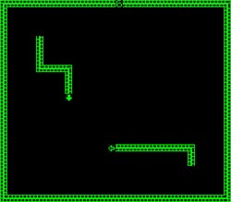
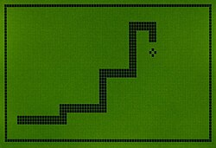
What is Snake?
1976 - Blockade
1997 – Snake For Nokia 6110 Cell phone

Slide 4
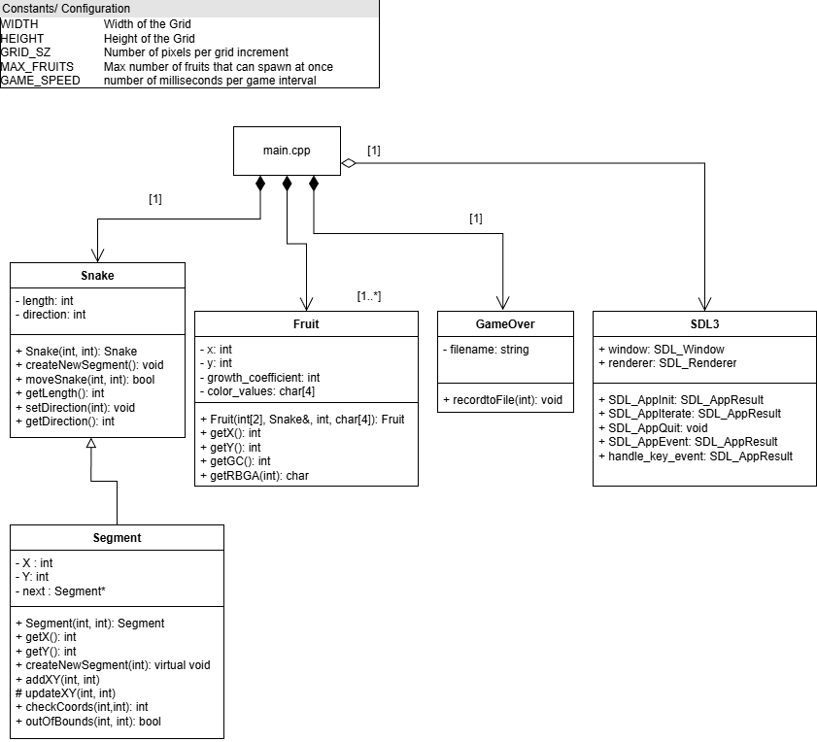
High Level Overview and UML Class Diagram

Slide 5
SDL3

Slide 6
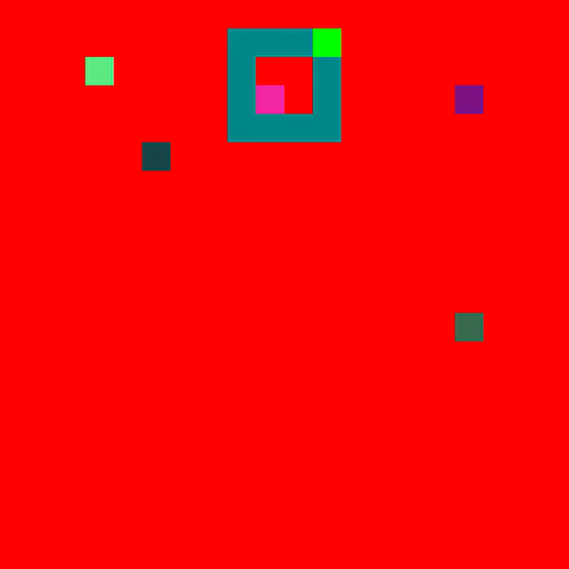
Our Snake

